Slide 1
Lucy Strong: Getting to a Successful Launch In Spite of a Once-In-A-Lifetime Pandemic and Lessons Learned
Donya Douglas-Bradshaw
Matt Garrison
Devin Poland

Slide 2
Agenda
Lucy Spacecraft Introduction
Project Management: Conquering Spacecraft Development in a COVID environment
Payload Systems Engineering: Development Lessons Learned
Mission Operations Management: Development and Phase E Lessons Learned
Development and Early Operations
Solar Array Anomaly

Slide 3
Lucy Spacecraft Introduction
Mission Description
Spacecraft Description
Lucy Partners
Lucy Trajectory and Science Targets

Slide 4
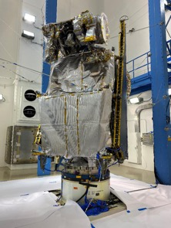
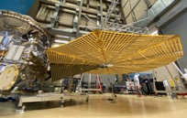
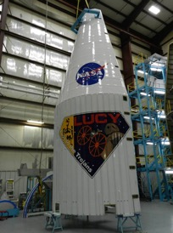
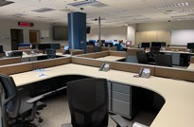
One Spacecraft, 9 Asteroids, 12 Years
Mission Description
PI-led Mission, Dr. Hal Levison
Category 2, Risk Class B, ~$1Bil LCC
11.6 yr mission
1 Main Belt Asteroid Rehearsal (2025)
5 Trojan Encounters (9 Asteroids) (2027-2033)
Science Objectives
Observations of surface geology, color/composition, interiors/bulk properties, and satellites/rings of Trojans
Diverse Trojan targets include C-, D-, and P- spectral asteroid types
Science Suite
L’Ralph – combined visible color imager and near infrared spectral mapper
L’TES – thermal emissions spectrometer
L’LORRI – high resolution panchromatic imager
TTCam – visible terminal tracking cameras for on-board guidance and control
Launch via NASA/KSC LSP
Launch Vehicle – ULA Atlas V 401
Launched: October 16, 2021 @ 5:34am EST
Lucy, like the human fossil for which it is named, will revolutionize the understanding of our origins by exploring the “fossils” of our solar system

Slide 5
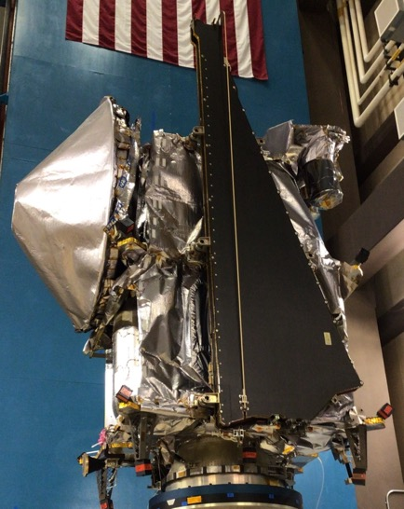
Lucy Spacecraft
Mass: ~1500 kg
Power @ 5.7 AU: ~410 watts
Size of spacecraft:
Stowed it’s about the size of a standard car
With the solar arrays deployed it spans the height of a 4-story building

Slide 6
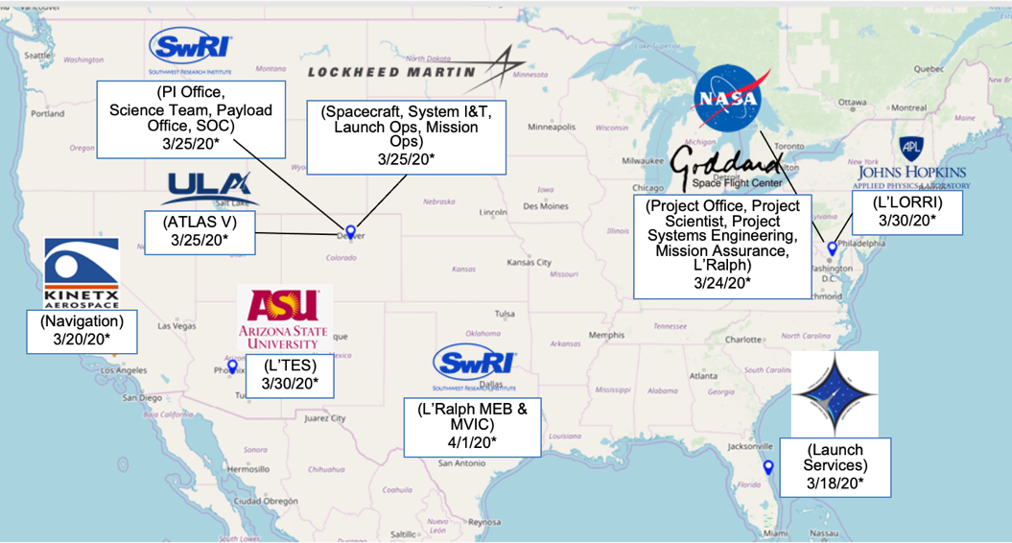
Lucy Partners
*Date when states issued stay-at-home orders or Centers transitioned to mandatory telework.

Slide 7
Orbit and Science Targets

Slide 8
Lucy Project Management
Project Milestones
COVID challenges and strategy
Project Management Take-aways

Slide 9
Lucy Met Every Milestone from Proposal Through its Critical Design Review
December 22, 2016: Selected on Discovery Program 2014 Announcement of Opportunity
June 14, 2017 – October 30, 2018: Preliminary Design and Technology Completion Phase
October 15 – 18, 2019: Successfully completed Mission Critical Design Review
October 30, 2018: Agency Confirmation Review and authorization to proceed into Final Design and Fabrication
October 31, 2018: My first day on the job as the Deputy Project Manager
October 31, 2018: Started Phase C: Final Design and Fabrication
August 1, 2019: ~ 9 months after joining the project, I took over as the Project Manager when the incumbent retired
But then came COVID-19…

Slide 10
COVID-19: Things Moved Rapidly in March 2020
March 10, 2020
“We Are Family”
March 14, 2020 "Taking Care of Our People"
March 16, 2020
“Coalescing Around a Shared Vision”
I was sitting in my office with Vince Elliott, my Deputy Project Manager for resources and we were discussing what had kept Lucy on track in spite of all the challenges we were experiencing through development. After given it some thought I got up and wrote three words on my white board “We are Family”.
NASA moved to Stage 2 of the Agency’s COVID-19 Response Framework - telework was strongly encouraged for employees who could work remotely. Given the unknown, unknowns, the PI and I met to discuss standing down for a year.
I held a Project wide All Hands to share the Project’s Go Forward Plan given the potentially limited/restricted access to work sites due to COVID-19 and to status the Project across all partner institutions.
March 24, 2020
“We Grow When We Face Challenges”
Agency directed Goddard to move to Stage 4 of the Agency’s COVID-19 Response Framework – Telework was mandatory for both Lucy and L’Ralph. L’Ralph had to “safe” their hardware. Travel was restricted. As I was turning off the lights and locking up the Lucy office suite, I wrote “Lucy Strong, Welcome Back” on the white board.
No one knew what the future held…

Slide 11
The Challenge
Context: By April 1st, every Lucy partner was operating under either a state issued stay-at-home order or mandatory telework. As a result, all hardware elements experienced some losses in efficiency/ productivity and/or schedule delays. In addition, there was anxiety around the lack of understanding of the coronavirus, and the potential impact to the team.
Challenge: Maintaining the health and safety of the team while delivering a spacecraft that met the science objectives within the cost and schedule constraints, with acceptable risks.
Eric Hoffer said that a “the leader has to be practical, and a realist yet must talk the language of the visionary and the idealist.”

Slide 12
The Strategy
First Things First: We established a Project wide COVID-19 protocols and response framework that was consistent with the Agency’s framework and CDC guidelines.
Project aggressively spent reserves to mitigate COVID-19 impacts and meet the planetary launch window.
Augmented teleworking capabilities, including virtual inspections.
Provided funding to bring on an additional surge support.
Carried additional liens to buy back schedule.
Built instrument mass simulators.
Utilized a very proactive “what-if” approach to assess “risk exposure”, identify trade space, and to develop work around plans for a number of scenarios, e.g. work stoppage due to COVID, late hardware delivery, etc.
Scrubbed the instruments and spacecraft test programs for optimization and to identify areas where we could assume more risk to save schedule.
”Testing as you fly” and ”Flying as you test” were critical considerations
Established new delivery dates that included contingency, as well as, slack.
Implemented additional oversight with daily tag-ups and weekly schedule reviews.
FAST, FAST-ER, Peace and Love, Be Like a Pineapple

Slide 13
The Strategy (cont.)
In June 2020 the Project implemented the FAST (Feasible ATLO Shortened Timeline) Plan, which:
Accommodated late delivery of key hardware, restored the critical path funded schedule margin, and maintained the ATLO start date and KSC ship date.
Maximized team resiliency to COVID-19, through both segregation of personnel, and utilization of weekend and alternate shift work where feasible.
Utilized tools such as ZOOM to enable off-site personnel to monitor integration activities as well as test telemetry “over the shoulder” of onsite personnel.
Part way through ATLO, the Project conducted a SWOT analysis to identify strengths, weaknesses, opportunities, and threats with the ATLO plan.
Project identified a total of twenty-three weaknesses/threats and twenty opportunities to mitigate schedule risks and further increase team resiliency for the remainder of ATLO and launch processing.
FAST, FAST-ER, Peace and Love, Be Like a Pineapple

Slide 14
The Strategy (cont.)
We could not lose site of the “human factor”. The Project’s success thus far, had hinged on the social/relationship equity built up over the years. So, the Project made a concerted effort to maintain the sense of team spirit including:
Virtual parties/gatherings, a team peer award program, “accomplishments of note”, established peer “buddies” for support, virtual bingo, social distanced gatherings, etc.
Project leadership traveling to work sites to show support to personnel required to work onsite.
Adding more frequent team wide meetings to facilitate communication.
It worked!
Notes:
At

Slide 15
We Found Inspiration in a Number of Things, Including a Pineapple
Teamwork: The fruit of the pineapple plant is actually 200-plus flowers coming together to form a single fruit.
Endurance and Perseverance: It can take up to three years for a pineapple fruit to grow ready for harvest. Like success, it doesn’t happen overnight. Time, patience, and hard work are all required to get results.
Versatility: The pineapple is not a one trick pony. It can be used to make wine, tenderize meat, serve as a fancy cup for your fruity, poolside drink, or a very non-traditional jack-o-lantern. Lesson here: look beyond the obvious in your teammates, tools, and ideas.
Common Vision, Common Goal

Slide 16
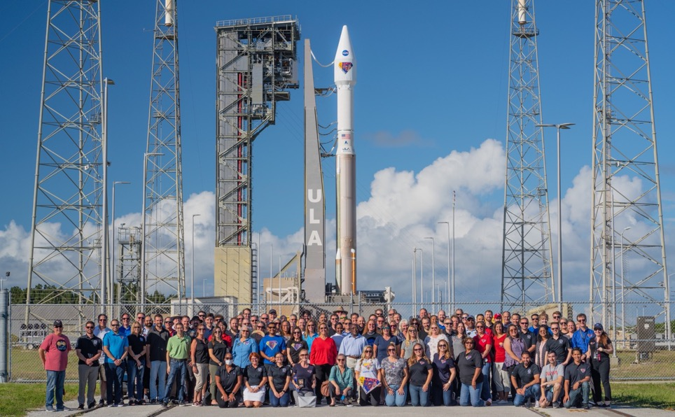
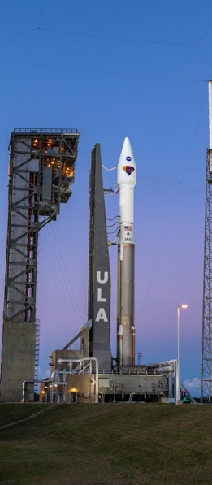
The Road to Launch: Begins and Ends With a Great Team!

Slide 17
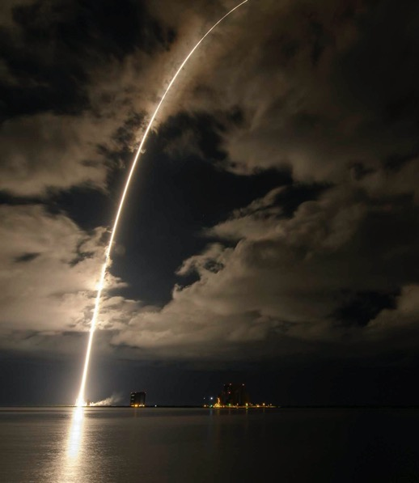
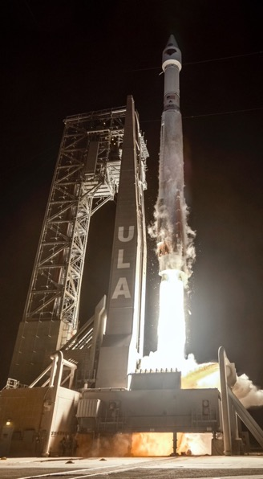
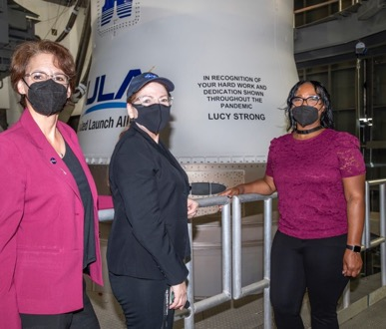
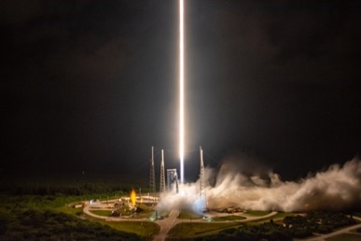
We Accomplished What We Set Out to Do
Lucy Launched on Day 1 Opportunity 1 of its 23 Day Planetary Launch Period on
16 October 2021 at 5:34 AM EDT/9:34 AM UTC!

Slide 18
Lucy Successfully Navigated COVID-19
GSFC adopted Agency COVID Framework and transitioned to mandatory telework for non-mission essential work. L’Ralph onsite work shuttered.
3/24/20
L’Ralph onsite work resumed.
6/8/20
Lucy System Integration Review
7/27/20 – 7/31/20
Key Decision Point-D (DPMC). $8.2Mil augmentation from HQ UFE.
8/25/20
L’TES AIRR
12/16/20
L’Ralph AIRR
1/25/21
S/C Modal Test Comp
3/13/21
S/C Acoustic Test Comp
3/20/21
S/C EMI/EMC Test Comp
4/30/21
Pre-Ship Review
7/20/21 – 7/21/21
Operational Readiness Review/Flight Readiness Review
8/20/21 – 8/12/21
Key Decision Point-E (DPMC)
9/21/21
Roll Out to the Pad!
10/14/21
Mar
2020
Apr
2020
May
2020
Jun
2020
Jul
2020
Aug
2020
Sep
2020
Oct
2020
Nov
2020
Dec
2020
Jan
2021
Feb
2021
Mar
2021
Apr
2021
May
2021
Jun
2021
Jul
2021
Aug
2021
Sep
2021
Oct
2021
Nov
2021
All Lucy partners under stay-at-home orders or mandatory telework. With the exception of L’Ralph, spacecraft and instrument hardware development continued with implementation of COVID-19 Protocols* and reduced (70%) efficiency.
4/1/20
Lucy baselined the FAST**.
6/28/20
Start of ATLO, Red & Blue Teams, and extended days (5x1).
8/10/20
L’LORRI ATLO Integration Readiness Review (AIRR)
10/29/20
Transition to 7x1 work week with Red/Blue & Orange/Green Teams
1/4/21
Lucy Pre-Environmental Review
2/16/21 – 2/18/21
S/C Sine Vibe Test Comp
4/12/21
S/C Tvac Test Comp
5/13/21 - 6/7/21
S/C Shipped to Astrotech. Continuation of FAST Plan
7/30/21
Safety and Mission Success Review 9/13/21
Launch Readiness Review
10/13/21
Lucy Launch!
10/16/21
*COVID-19 Protocols: Expanded telework, restricted travel, virtual inspections, face coverings, limited onsite work, social distancing, more frequent cleaning, mandatory 14-day quarantine and isolation after exposure. Where feasible, intact, isolated work groups/teams.
**Feasible ATLO Shorted Timeline (FAST) – Project wide framework to mitigate COVID-19 impacts and accommodate late hardware delivery with blue/red teams and 5x1.5days/week. Transitioned to 7days/week at start of environments.
Lucy launched on time and under budget during a pandemic;
compressing 9.5 months of work into 7 months, while keeping the team safe!

Slide 19
Main Takeaways
FAST/FAST-ER came at a price – we pushed hard for 10.5 months under very taxing circumstances. As time progressed, the team brittleness became apparent.
This would not have been sustainable under normal circumstances.
Lucy was successful in navigating COVID and launching on time for a number of reasons:
We balanced time, cost, and performance, with risk as the discriminator.
Risk management was continuous. We developed mitigation strategies with offramps.
Schedule was king. Every decision took into account the potential schedule impact.
We had healthy cost reserves, which were used to buy surge support and time.
We were single-minded in our vision, to get to launch and have a successful mission – decisions were made collectively (meaning all trade space was put on the table).

Slide 20
Main Takeaways (cont.)
The PI and PM established a familial, inclusive, teaming/partnering culture from the beginning of the project. One badge.
We maintained a people first, mission always mindset.
We looked beyond the obvious in each other, our tools/assets, and ideas.
We worked hard and played harder - together.
We held each other accountable.
We embodied the characteristics of family…openness, grace, appreciation, interest in each other and our lives. We took care of each other. We stepped in to help each other, filling in the gaps as needed.
It was important for the leadership team (PI, PM, DPMs, Project Scientist) to show that we were in the arena too
We demonstrated that we were indeed, Lucy Strong!

Slide 21
Payload Lessons Learned
L’Ralph instrument team held periodic lessons-learned discussions.
Also held payload-level lessons learned discussion after launch including instruments, payload systems, and SC payload accommodations SEs
I’ve got a long list of these available off-line if anybody wants them.
L’Ralph
ISE
PSE
Inst. Accom.

Slide 22
Payload Lessons Learned: ISE Approach
CSR teams are often focused on showing feasibility and may not result in a self-consistent design (it is Phase A after all). Detailed mass scrub of the instrument MELs found significant under-accounting coming out of the CSR. Soon after award the engineering team should do a detailed scrub to verify that their starting point is an accurate and self-consistent design. The proposed concept cannot be treated as gospel.
L’Ralph instrument team held an internal process improvement talk after each major milestone including an option for anonymous submissions. The lead SE job is often in service of the team; tailor your communications, meetings, and processes to their needs.

Slide 23
Payload Lessons Learned: FPGAs and FSW
We had minor schedule delays in the FPGA review process because we were not proactive enough lining up a reviewer. The review identified and helped fix a few issues in the flight code. Work with 560 early on to identify FPGA reviewers and include them in your schedule alongside other tabletops.
LRalph had an experienced instrument operator who joined the team around flight electronics build. Early on they identified changes to the electronics and FSW that would have streamlined testing and operations but it was too late to act on most of those. Identify who your test leads are in time for them to influence requirements and early designs.
Instrument FSW was developed by a subcontractor at level 5 but formal project SW approval didn’t happen until level 2. At that point it had been reviewed and processed through 4 different CM systems. Try to avoid a structure like that, but if you can’t make sure that the project SW lead is a required reviewer at the lowest level too.

Slide 24
Payload Lessons Learned: FSW Interfaces w/ SC
There were multiple FSW interface issues not discovered until the instrument was delivered to the spacecraft. Instrument testing used instrument-provided EGSE that was designed to mirror the interface in the SC ICD. If the SC is not providing interface EGSE at least make sure that the SC electrical and software teams review the instrument-provided interface EGSE.
Timing interactions between instrument data playbacks and SC processing of that data took way longer than anybody expected. This drove a last-minute rework of the encounter ConOps and some key ground tests. Make sure requirements and ConOps documents capture any critical timing. When processes are split across an interface make sure the details are explained in the ICD.

Slide 25
Payload Lessons Learned: Fatigue Failure
L’Ralph failed to identify a fatigue sensitivity on a thermal isolator design which resulted in two consecutive vibration failures of ETUs. Before PDR make sure to review your designs for fatigue-sensitive components or ConOps that could lead to fatigue like Dragonfly’s multi-hour sine vibration environment.
Solution to the fatigue issue was to increase thickness of the thermal isolators. This resulted in more heat leak into the cryo zone but allowed the isolators to survive launch. When competing requirements constrain a design make sure to assess margins and risk against those constraints.

Slide 26
Payload Lessons Learned: Delivering Flight Systems in a Pandemic
When I asked for lessons learned about how to deliver a flight instrument during a pandemic, the LORRI ISE’s response summed it up well: “Don’t.”
BUT there were some lessons that would apply to any cost- or schedule-constrained build:
Look through your I&T schedule to identify every major activity (how long is major depends on your build and your sensitivity)
Identify whether each activity is required to have a minimally-viable flight system (aligning optics) or whether it’s risk reduction (verifying alignment hasn’t changed after some environment). Note that most verification activities probably fall into the second bucket.
Use the risk management process to identify and prioritize scope reductions in those risk reduction activities. Be prepared for some hard discussions with the team and external stakeholders.
Circle back through this process regularly as I&T progresses

Slide 27
Mission Operations
Ground System and Operations Development
Launch and Early Orbit Preparation and Strategy
Solar Array Anomaly

Slide 28
Ground System Readiness
Early Planning and Communication
Creating and communicating an integrated ground system development schedule allowed the teams to integrate fairly seamslessly
Interleaving activities so that everyone knows dependencies
Dry runs can be the official run for record if you plan correctly cutting down on overall workload
Early planning allowed us to identify remote access capabilities and requirements for execution of GRTs, ORTs etc. in a COVID environment

Slide 29
Implemented Lessons Learned
Lesson | Implementation
MVN: Need clear delineation between Ops and Ground Sys development. Assign 2-3 FTE early to GS&O team | Other than Ops Readiness Test Director, GS&O team established pre-PDR
MVN: Development & Integration Schedule should be prepared prior to PDR | Ground Integrated Master Schedule was up and running by MPDR
MVN: Implement ‘top-down’ req derivation and vet heritage requirements | Flowed L3 req directly from L2 and added heritage req to fill gaps to complete system
MVN: Project must own a core set of documentation | Mission Plan, MOCD, GSRD, ICDs, OIAs and SISs owned by GS&O
OREX: Several Ground SE functions reported to PSE; dPSE managed the ConOps | Ground Lead oversees all Ground functions, reports to PSE. Ground manages the ConOps
OREX: SPOC was originally given development freedom | GS&O and SOC personnel consciously built strong technical relationship
OREX: SPOC development started prior to architecture being well thought out | SOC focused on requirements and design during Phase B
OREx: NAIF processing of attitude kernels delayed OpNav image availability | Increased spacecraft pointing accuracy and LORRI dynamic range eliminate the need for reconstructed attitude kernels, removing the dependency on NAIF processing.
It is important to start building sequences early to allow sufficient time for revisions, shaking out tools, and uncovering issues. Early builds reduce the chance of needing a second pass between SOC and MOC in the time-constrained weeks leading up to an encounter. | The SOC conops include early development of "V0-draft" and "V0" versions of encounter designs before the "V1" implementation that is handed off to the MOC.
From FOR/ORR: Thank you Mark Woodard

Slide 30
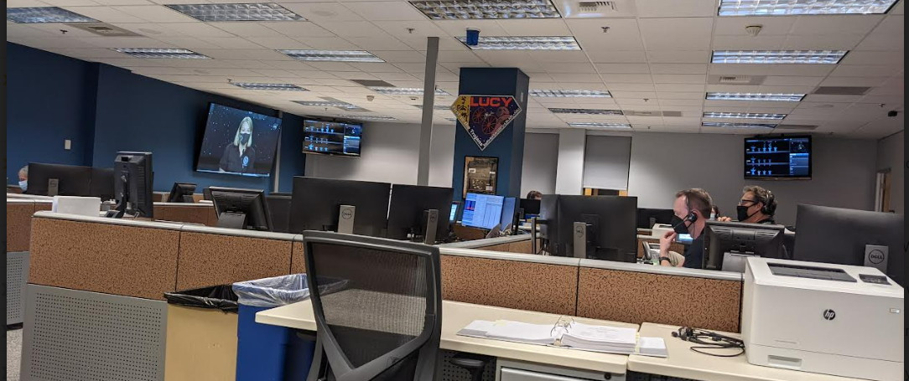
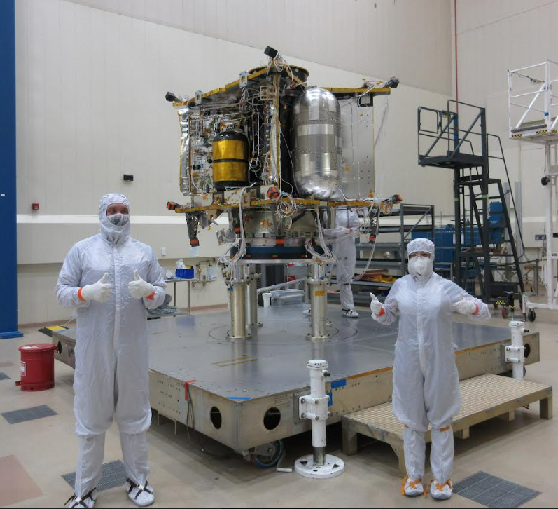
Mission Operations
Overall Operations Integration
Include all mission elements early on in the development process made a big difference between Lucy and ORX readiness
Starting block development, even if those versions are placeholders or it is known that they will need updates. Having that foothold was as important for readiness as it was for moral
Bringing MOM on almost a year prior to launch allowed for smoother integration, long term L&EO planning
All L+30 products were on the shelf prior to launch, were developed at an ‘easier’ pace. Planning for sequence development began 9 months prior to launch with regular meetings etc.
Simulator capabilities and requirements
It would have been helpful to explicitly define requirements and capabilities of simulators
Definition of these requirements and capabilities would lead to less confusion and would have had their own schedule and plan to go along with them
Lucy still has outstanding simulator related requirements that have to be verified
Personnel and staffing
Should plan to retain certain development engineers, particularly simulator design engineers, for some time into phase E (potentially as late as after some early checkouts) in order to work out issues with simulators based on what was discovered in flight
Subsystems and systems engineers supporting ATLO/I&T transitioned to operations maintaining continuity
Planning for post launch personnel fatigue and allowing down time as you can
People are going to be exhausted leading up to and following a launch campaign. Prior to launch define and communicate an integrated staffing plan for mission elements for the first several weeks so that people can take time off to recharge
Phase E cost discussions
Plan to have several cost summits for phase E especially if there may need to be cost considerations
Discuss potential cost trades for phase E contracts early on so that you know what the trade space needs to be when finalizing phase E contracts
Initial Phase E cost estimates at cost summits had some unfortunate assumptions which would have benefited from additional detailed reviews of cost plans
A number of cost trades were discussed during the finalization of contracts which would have benefited from additional time for discussion

Slide 31
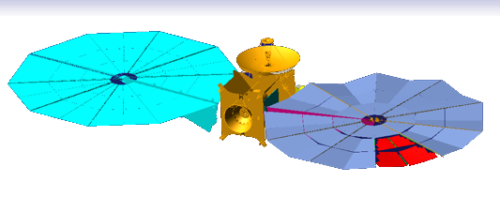
Solar Array Anomaly
Lucy launched out of CCSFS on October 16, 2021 at 5:34 am (EST).
The spacecraft separated from the launch vehicle approximately 58 minutes after launch.
Shortly after separation both solar arrays were commanded to deploy.
The -Y Solar Array (SAMY) unfurled and latched nominally.
However, the +Y Solar Array (SAPY) did not fully unfurl, nor latch.
Subsequent analysis shows the array was at ~330°.
It is producing > 90% of expected power.
Spacecraft is fully functional besides this
We performed a series of re-deployment attempts
Have gotten the array to 352 - 355°.
13”-20” of lanyard remaining until latch.
Saw increased tensioning of array
→ increase the likelihood that we will be able to fly the mission unlatched.
Paused because of Lucy’s location in the Solar System.

Slide 32
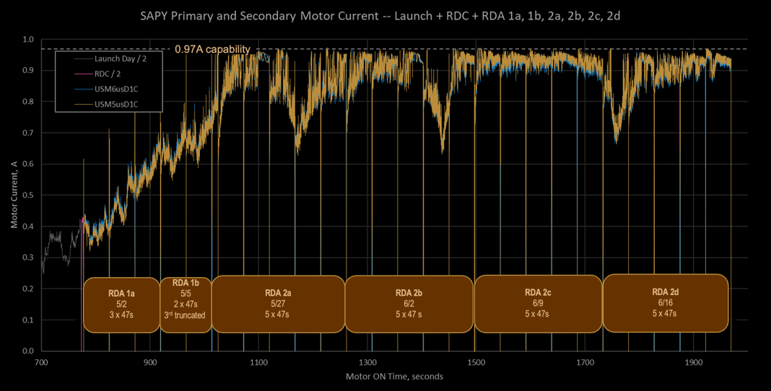
Motor Current as a Diagnostic
Low current dips are most productive
42.9″
12.1″
6.4″
5.7″
1.5″
3.8″
= 72.4″

Slide 33
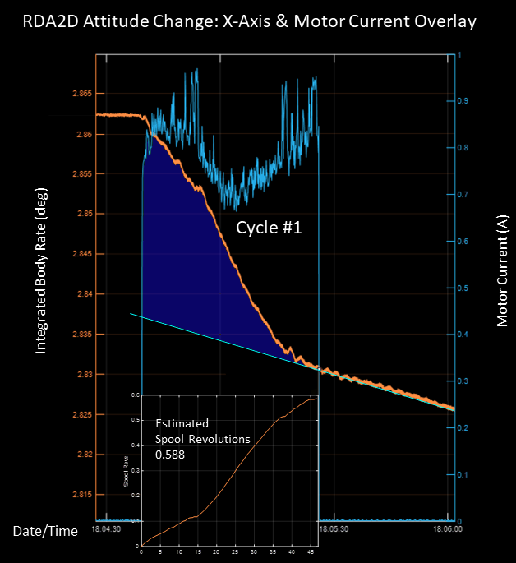
Lanyard Take-up Estimation: Conservation of Mom
Integrating high rate IMU data allows for lanyard take up estimation.
Makes use of the conservation of angular momentum.
Area shows the retraction of the array
Slope is residual drift rate from ACS transition to RWA track hold

Slide 34
SA Anomaly Lessons Learned (Ops)
Jessica and Mike have detailed SE development LLs, focus is on operations.
Deployment telemetry
No direct measurement mechanism to discern how far the array had been deployed.
It would be very helpful to have something that spoke to the state of deployment in telemetry at a data rate that allows for better understanding of the system
Take a breath, don’t act immediately
What is the real impact of taking a beat?
During the initial discovery of this anomaly we had put forth a plan to start doing what would be RDAs within the first couple of weeks. Cooler heads must prevail.
It was important to execute an extensive ground test campaign and make sure that our flight experience was enveloped by our ground test experience.
Developing L&EO products early allowed us to focus on the anomaly instead of having to work nominal product development in the high-stress environment
Openness of communication during anomaly meetings
Everyone’s opinion and perspective is of high value
‘Badge-less’ environment was very important. Make sure that you hear everyone’s perspective, even though it may make for long meetings and discussions

Slide 35
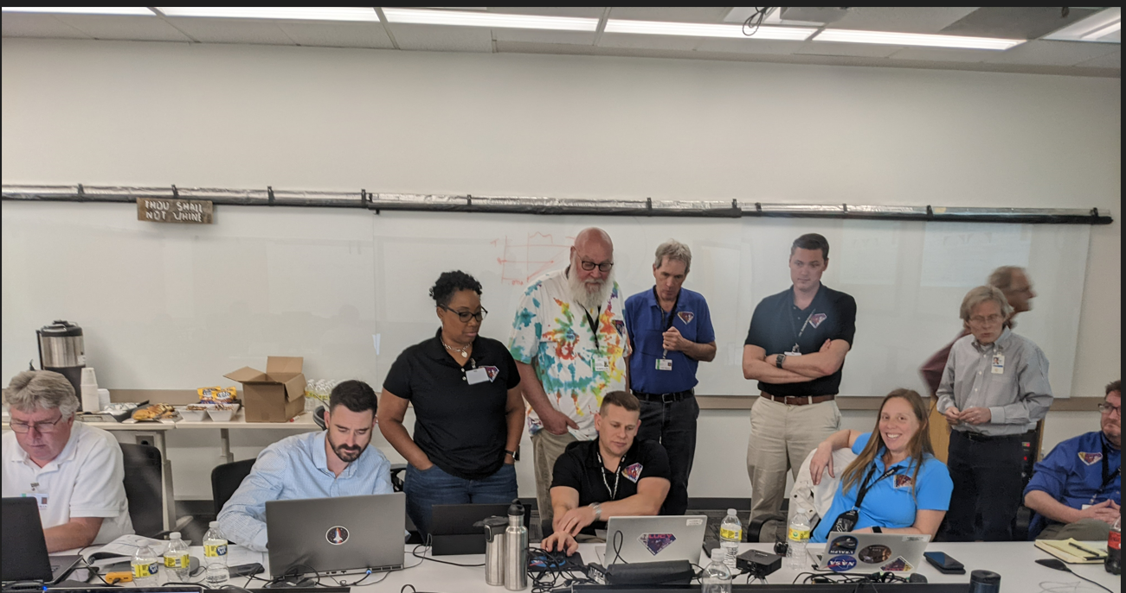
First RDA Execution May 2022!
Once a team, Always a team!

